Slide 1


The Data Behind Chess
Taylor Anderson

Slide 2
My Statistical Question and Data
Statistical Question
Is there a correlation between the rating difference of the two chess players and the number of turns in the game? My hypothesis is that the larger the difference in ratings the players are, the shorter the game will be. Evenly matched players will have longer games.
Data Set
My data set is made up of around 20,000 games from the website lichess.org. There are 16 variables including number of turns, winner, ratings, openings, and move orders.

Slide 3
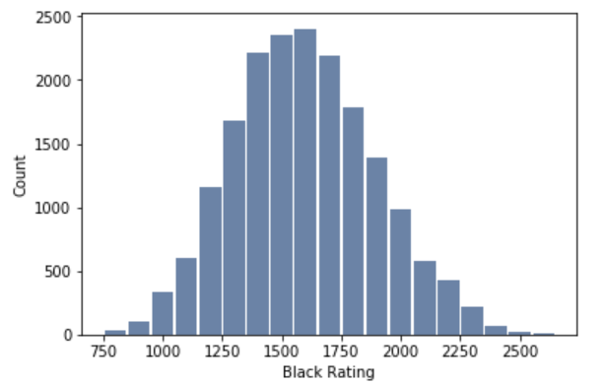
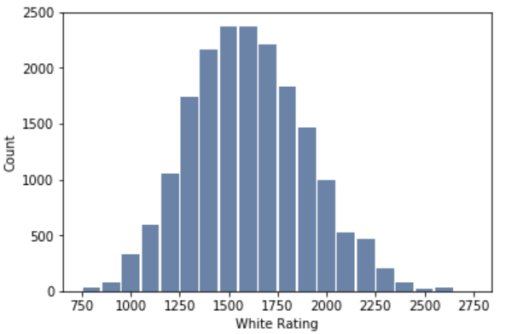
Variables
Black Rating
White Rating
Mean: 1595
Standard Deviation: 297
Mode: 1400
Mean: 1602
Standard Deviation: 297
Mode: 1480

Slide 4
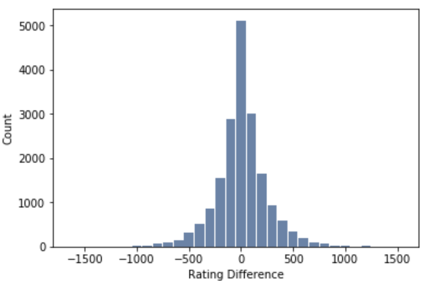
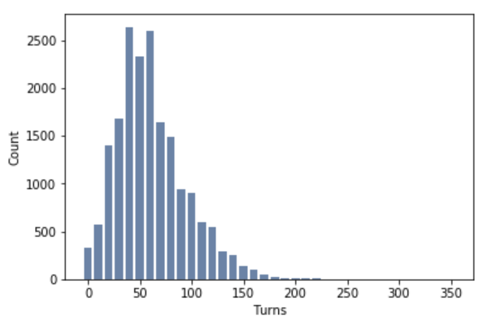
Variables, cont.
Rating Difference Between Players
Number of Turns in a Game
Mean: 7.53
Standard Deviation: 246
Mode: 0
Mean: 61
Standard Deviation: 34
Mode: 51

Slide 5
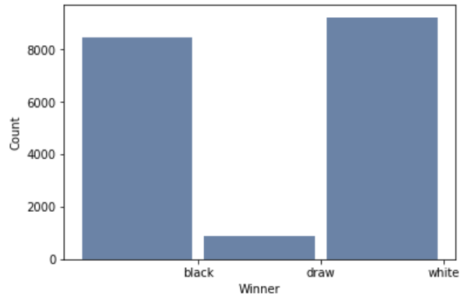
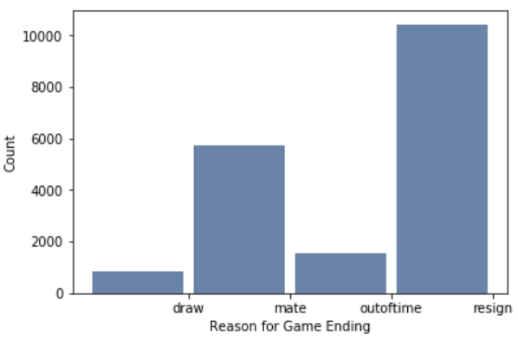
Variables, Cont.
Game Winner
Reason for Game Ending

Slide 6
Initial Thoughts
I chose to remove all games with players ranked 1500. This is shown in my Jupyter Notebook, but I had a huge peak at 1500 while the rest of the distribution was relatively normal. I discovered that lichess.org starts all new players at rank 1500 so most people at that rank are really an unknown rank. I thought that it would be less of an impact on the data if I just removed those games.
My second concern was that the rating difference of players is not at all normal. I should have expected this because a chess website would be set up to have similar ranked people player each other so that everyone could have a good experience. This may make it more difficult to find a correlation because there is very little data in the tails but we will move forward.

Slide 7
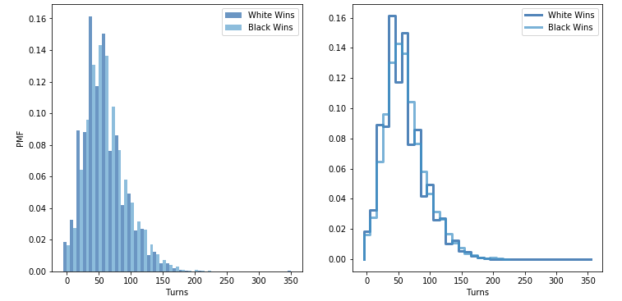
Probability Mass Function
There is no clear difference between the length of games black wins compared to white. The only possibility I see is that white may be more likely to win early which would make sense because going first is a large advantage early in the game and lessens over time.

Slide 8
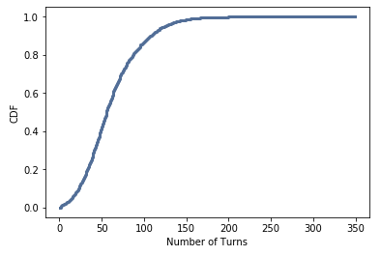
Cumulative Distribution Function
Here we can see that very few games make it past 150 turns (1.5%). 42% of games end before the 50th turn and 87% of games finish before the 100th turn. This makes sense because we saw earlier that our average game length was 61 moves.

Slide 9
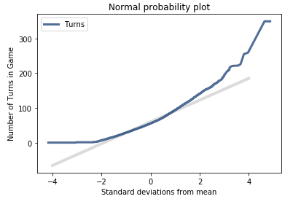
Normal Probability Plot
This plot shows us how much our data distribution matches the standard normal bell curve. It is very clear that the data does not follow it very well. This confirms what we saw in our histogram earlier. The data for turns has a severe right skew.

Slide 10
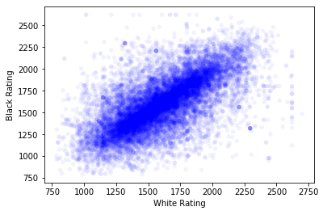
White Rating vs. Black Rating
This is an interesting example that correlation does not mean causation. This data has a coefficient of correlation of 0.65 which means they are correlated. It is unlikely that the rating of one player directly causes the rating of the other. Instead, there is an indirect causation that lichess.org matches similarly ranked players to play eachother.

Slide 11
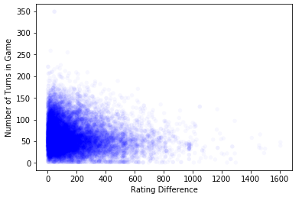
Rating Difference vs. Number of Turns
The first time I worked with this plot I had both negative and positive differences (white being positive). This wouldn’t work with a linear model, so I changed all of the rating differences to their absolute value. Here we only got a coefficient of correlation value of -0.13. While this is in the direction of my hypothesis it is hardly significant.

Slide 12
Correlation Permutation Test
I ran the correlation permutation test that we learned about in our book to test if there is a statistically significant correlation between the difference in rating of players and the number of turns in the game. While the coefficient of correlation was small, I found that the correlation that exists is statistically significant with a p-value < 0.05.

Slide 13
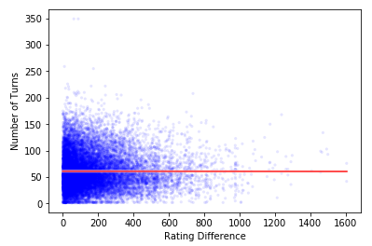
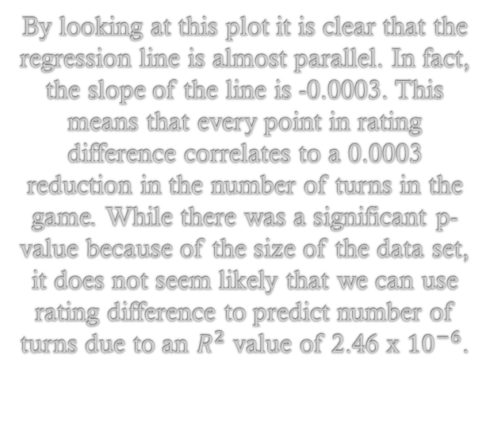
Linear Regression
By looking at this plot it is clear that the regression line is almost parallel. In fact, the slope of the line is -0.0003. This means that every point in rating difference correlates to a 0.0003 reduction in the number of turns in the game. While there was a significant p-value because of the size of the data set, it does not seem likely that we can use rating difference to predict number of turns due to an $R^{2}$ value of 2.46 x ${10}^{−6}$.

